Slide 1

Intro to Databricks Delta Lake
February 21, 2020

Slide 2
Personal introduction
Mykola Zerniuk - Java / Scala Developer / Data Engineer
Andrii Lenets - Java / Scala Developer / Data Engineer

Slide 3
Outline
Data lake problems
Spark and ACID
Delta Lake key features overview
Comparison with similar data lake storage layers

Slide 4
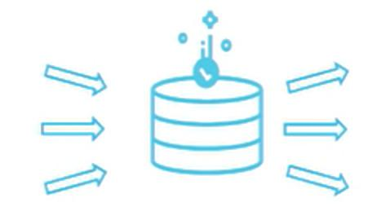

Data challenges with data lakes
Reliability issues
Failed production jobs leave data in corrupt state requiring tedious recovery
Lack of schema enforcement creates inconsistent and low quality data
Lack of consistency makes it almost impossible to mix appends and reads, batch and streaming
Performance issues
File size inconsistency with either too small or too big files
Partitioning, while useful, can be a performance bottleneck when a query selects too many fields
Slow read/write performance of cloud storage compared to file system storage

Slide 5


Apache Spark and ACID
Why ACID is critical?
Atomicity - all or nothing
Consistency - data is always in a valid state
Isolation - an operation must be isolated from other concurrent operation
Durability - once committed data is never lost

Slide 6


Slide 7
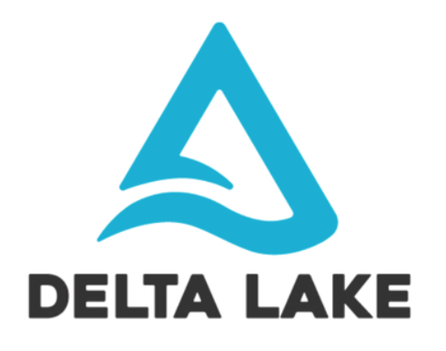
Delta Lake key features
100% Compatible with Apache Spark API
ACID Transactions
Updates and Deletes
Time Travel (data versioning)
Schema Enforcement / Schema Evolution

Slide 8

ACID Transactions
Delta Lake Transaction Log
Single Source of Truth
The Implementation of Atomicity on Delta Lake
Consistency support
Isolation and Durability out of the box
https://databricks.com/blog/2019/08/21/diving-into-delta-lake-unpacking-the-transaction-log.html

Slide 9
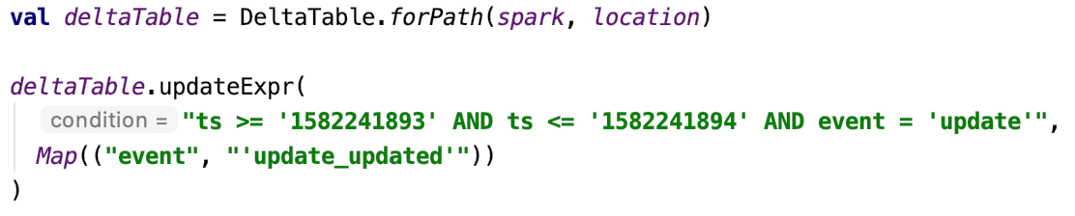
Updates and Deletes

Slide 10

Time travel
Common Challenges with Changing Data
Audit data changes
Reproduce experiments & reports
Rollbacks
Introducing Time Travel
By version number
By timestamp

Slide 11
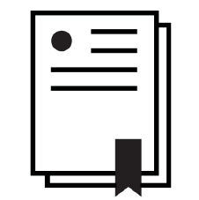
Schema Enforcement
How Is Schema Enforcement Useful?
What Is Schema Evolution?
Delta Lake Schema Evolution Options:
Merge schema
Overwrite schema

Slide 12

Delta Lake Transaction Log
How Does the Transaction Log Work
Breaking Down Transactions Into Atomic Commits
The Delta Lake Transaction Log at the File Level
Quickly Recomputing State With Checkpoint Files
Dealing With Multiple Concurrent Reads and Writes

Slide 13
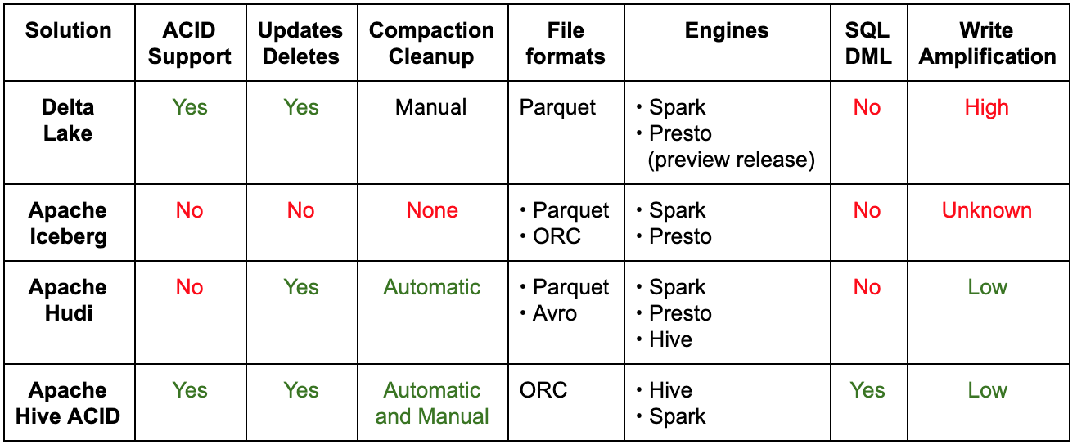
Similar storage layers

Slide 14
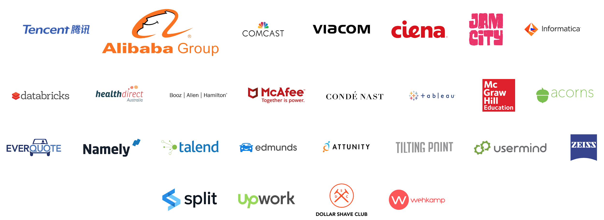
Users of Delta Lake

Slide 15
References
https://delta.io/
https://docs.delta.io/latest/index.html
https://databricks.com/blog/2019/08/21/diving-into-delta-lake-unpacking-the-transaction-log.html
https://databricks.com/blog/2019/09/24/diving-into-delta-lake-schema-enforcement-evolution.html
https://databricks.com/blog/2019/02/04/introducing-delta-time-travel-for-large-scale-data-lakes.html
Building Robust Production Data Pipelines with Databricks Delta - https://youtu.be/_-6jqiLnJUM

